Slide 1
Circuits and Computers
Stem Robotics 101
Unit 2
Overview:
This unit delves into some of the underlying technologies of robotics in general, and then explores each within the context of the Lego MINDSTORMS NXT robotics kit. First, electrical circuits are covered followed by exercises using the NXT as a circuit and demonstrating the function of each of the NXT sensors in View Mode. Second, the topic of computers is covered, including both the history (Moore's Law) and parts of computers. The NXT is then used to demonstrate the parts of computer using the built-in Try-Me programs.

Slide 2
Circuits and Switches
U2C1

Slide 3
2.1 Circuits and Switches
Overview:
The goal of this lesson is to explore the basics of circuits and switches to provide an understanding of some electrical concepts underlying robotics technology. The lesson utilizes resources from Intel's "The Journey Inside: The Computer" series.
Objectives: Students will be able to:
1. Describe the four parts of a circuit
2. Name an example of a circuit
3. Categorize the parts of a given circuit
4. Differentiate between Insulators, Conductors and Semiconductors
5. Name examples of Insulators, Conductors and Semiconductors

Slide 4
Worksheet
Circuits & Switches
Name:___________________ Period:___ Date:_____ Score:__/15
(2 pts) Name the four parts of a circuit:
(4 pts) Briefly describe each of the four parts:
(3 pts) Give an example of a circuit in your world (other than the power grid in the video, or a flashlight), and identify its four parts:
(3 pts) What are the characteristics of an insulator, conductor and semiconductor.
(3 pts) Give an example of an insulator, conductor and semiconductor
INTEL_JOURNEY_INSIDE-chapter2
Notes:
Review the Circuits and Switches Worksheet with students before watching the Intel Video: Circuits and Switches
Answer Key: Circuits & Switches Worksheet
Power source Conducting Path Switch Load
Power source – pump that pushes electrons around the circuit (e.g. battery) Conducting path – path through which electrons move (e.g. wires) Switch – means to turn on and off the flow of electrons (e.g. light switch) Load – part of the circuit that does something useful (e.g. light bulb)
Many possible answers, for example: Flashlight - Power source: batteries, Conducting path: wires, Switch – slider switch, Load – lamp bulb
Conductors allow electrons to move freely Insulators do not allow electrons to move freely (they don’t conduct) Semiconductors allow electrons to move freely only under certain conditions, and do not under other conditions (act like either a conductor or insulator, depending on the conditions)
Assessment: Circuits and Switches_Worksheet
Submitted by Randy Steele on 10 July, 2011 - 15:18
Printer-friendly versionPDF version Assessment Type: Written quiz / test
The attached Circuit and Switches Worksheet Word file is used in conjunction with the Intel video "Circuit and Switches" from "The Journey Inside: The Computer" series.
Attached Resource: Circuit and Switches Worksheet.doc
Answer key: Circuits and Switches_Worksheet

Slide 5
The 4 Parts of a Circuit
(5:04)
Discuss with your partner:
  What are the 4 parts of a circuit?
  What does each do?
  What are some examples of each?
  Give an example of a circuit. (Other then the power grid in the video)
Example
Notes:
The Four Parts of a Circuit
If possible, demo a simple circuit with a small lamp (see Extended Instructional Material) and recap video:
Power Source – battery in demo circuit
Conducting Path – wires in demo circuit
Switch – mechanical switch in demo circuit
Load – lamp in demo circuit
If a real-life demo is not possible, this virtual circuit from the Intel companion site for the video may be used.
Ask students for other examples of circuits in their lives
Give an example circuit and ask student to identify the four parts. For example:
Headlights in a car
Electric toothbrush
MP3 player (ipod)

Slide 6
Review Question 1
Which part of a circuit would a wire be?
A) Power Source
B) Conducting Path
C) Switch
D) Load
E) None of the above
Notes:
Which part of a circuit would a wire be?
A) Power Source
B) Conducting Path
C) Switch
D) Load
E) None of the above

Slide 7
Review Question 1
Which part of a circuit would a wire be?
A) Power Source
B) Conducting Path
C) Switch
D) Load
E) None of the above
Notes:
Which part of a circuit would a wire be?
A) Power Source
B) Conducting Path
C) Switch
D) Load
E) None of the above

Slide 8
Review Question 2
Which part of a circuit acts like a pump for electrons?
A) Power Source
B) Conducting Path
C) Switch
D) Load
E) None of the above
Notes:
Which part of a circuit acts like a pump for electrons?
A) Power Source
B) Conducting Path
C) Switch
D) Load
E) None of the above

Slide 9
Review Question 2
Which part of a circuit acts like a pump for electrons?
A) Power Source
B) Conducting Path
C) Switch
D) Load
E) None of the above
Notes:
Which part of a circuit acts like a pump for electrons?
A) Power Source
B) Conducting Path
C) Switch
D) Load
E) None of the above

Slide 10
Review Question 3
Which part of a circuit does something useful for you?
A) Power Source
B) Conducting Path
C) Switch
D) Load
E) None of the above
Notes:
Which part of a circuit does something useful for you?
A) Power Source
B) Conducting Path
C) Switch
D) Load
E) None of the above

Slide 11
Review Question 3
Which part of a circuit does something useful for you?
A) Power Source
B) Conducting Path
C) Switch
D) Load
E) None of the above
Notes:
Which part of a circuit does something useful for you?
A) Power Source
B) Conducting Path
C) Switch
D) Load
E) None of the above

Slide 12
Review Question 4
Which part of a circuit is made only out of insulators?
A) Power Source
B) Conducting Path
C) Switch
D) Load
E) None of the above
Notes:
Which part of a circuit is made only out of insulators?
A) Power Source
B) Conducting Path
C) Switch
D) Load
E) None of the above

Slide 13
Review Question 4
Which part of a circuit is made only out of insulators?
A) Power Source
B) Conducting Path
C) Switch
D) Load
E) None of the above – Insulators protect you from the circuit, ensure it stays a closed circuit!
Notes:
Which part of a circuit is made only out of insulators?
A) Power Source
B) Conducting Path
C) Switch
D) Load
E) None of the above

Slide 14
Review Question 5
Which part of a circuit stops the flow of electrons?
A) Power Source
B) Conducting Path
C) Switch
D) Load
E) None of the above
Notes:
Which part of a circuit stops the flow of electrons?
A) Power Source
B) Conducting Path
C) Switch
D) Load
E) None of the above

Slide 15
Review Question 5
Which part of a circuit stops the flow of electrons?
A) Power Source
B) Conducting Path
C) Switch
D) Load
E) None of the above
Notes:
Which part of a circuit stops the flow of electrons?
A) Power Source
B) Conducting Path
C) Switch
D) Load
E) None of the above

Slide 16
Conductors and Insulators
(1:46)
Discuss with your partner:
  What is a conductor?
  What is an Insulator?
  What is a Semiconductor?
  What are some examples of each?
What is Electricity?
Conductor or Insulator?
Notes:
Have student take notes during the video
If desired, use the Circuits and Switches Video Review PowerPoint presentation in conjunction with the video to pause for discussion questions and links to supplemental resources on Intel's companion web site. Note: the time under the title of each slide indicates when to pause the video.

Slide 17
Review Question 6
What do we call a material that lets electricity flow through it easily?
A) Wire
B) Copper
C) Conductor
D) Insulator
E) None of the above
Notes:
What do we call a material that lets electricity flow through it easily?
A) Wire
B) Copper
C) Conductor
D) Insulator
E) None of the above

Slide 18
Review Question 6
What do we call a material that lets electricity flow through it easily?
A) Wire - Is a conductor.
B) Copper - Is a conductor.
C) Conductor
D) Insulator
E) None of the above
Notes:
What do we call a material that lets electricity flow through it easily?
A) Wire
B) Copper
C) Conductor
D) Insulator
E) None of the above

Slide 19
Review Question 7
What do we call a material that does not let electricity flow through it easily?
A) Wire
B) Circuit
C) Conductor
D) Insulator
E) None of the above
Notes:
What do we call a material that does not let electricity flow through it easily?
A) Wire
B) Circuit
C) Conductor
D) Insulator
E) None of the above

Slide 20
Review Question 7
What do we call a material that does not let electricity flow through it easily?
A) Wire
B) Circuit
C) Conductor
D) Insulator
E) None of the above
Notes:
What do we call a material that does not let electricity flow through it easily?
A) Wire
B) Circuit
C) Conductor
D) Insulator
E) None of the above

Slide 21
Review Question 8
Copper is an example of a….
A) Wire
B) Circuit
C) Conductor
D) Insulator
E) None of the above
Notes:
Copper is an example of a….
A) Wire
B) Circuit
C) Conductor
D) Insulator
E) None of the above

Slide 22
Review Question 8
Copper is an example of a….
A) Wire
B) Circuit
C) Conductor
D) Insulator
E) None of the above
Notes:
Copper is an example of a….
A) Wire
B) Circuit
C) Conductor
D) Insulator
E) None of the above

Slide 23
Review Question 9
Plastic is an example of a….
A) Wire
B) Circuit
C) Conductor
D) Insulator
E) None of the above
Notes:
Plastic is an example of a….
A) Wire
B) Circuit
C) Conductor
D) Insulator
E) None of the above

Slide 24
Review Question 9
Plastic is an example of a….
A) Wire
B) Circuit
C) Conductor
D) Insulator
E) None of the above
Notes:
Plastic is an example of a….
A) Wire
B) Circuit
C) Conductor
D) Insulator
E) None of the above

Slide 25
Computer Circuits
(7:21)
Discuss with your partner:
  What is a transistor?
  What does it do?
  What is it made out of?
  If it is neither a conductor nor an insulator, what type of material is it?
Transistors, Nonmechanical Switches
Transistor Cross-section
Notes:
Insulators, Conductors and Semiconductors
If possible, demo a simple circuit with small lamp and recap video:
Conductor – the wires
Insulator – plastic coating on wires
Use this circuit to test different material to determine whether they are insulators or conductors (see Extended Instructional Material)
Swap lamp in demo circuit for LED
Show the LED only lights when connected one way to power source
LED is semiconductor – only conducts electricity under certain conditions
If a real-life demo is not possible, this virtual test circuit for solids and this one for liquids from the Intel companion site for the video may be used.

Slide 26
Review Question 10
Computers use switches called…
A) Circuits
B) Transistors
C) Insulators
D) Loads
E) None of the above
Notes:
Computers use switches called…
A) Circuits
B) Transistors
C) Insulators
D) Loads
E) None of the above

Slide 27
Review Question 10
Computers use switches called…
A) Circuits
B) Transistors
C) Insulators
D) Loads
E) None of the above
Notes:
Computers use switches called…
A) Circuits
B) Transistors
C) Insulators
D) Loads
E) None of the above

Slide 28
Review Question 11
Transistors are made out of….
A) Silicon
B) Copper
C) Electrons
D) Computers
E) None of the above
Notes:
Transistors are made out of….
A) Silicon
B) Copper
C) Electrons
D) Computers
E) None of the above

Slide 29
Review Question 11
Transistors are made out of….
A) Silicon
B) Copper
C) Electrons
D) Computers
E) None of the above
Notes:
Transistors are made out of….
A) Silicon
B) Copper
C) Electrons
D) Computers
E) None of the above

Slide 30
Review Question 12
True or False: Modern transistors are huge!
Notes:
True or False: Modern transistors are huge!

Slide 31
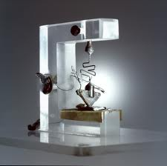
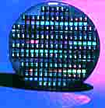
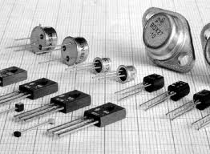
Review Question 12
True or False: Modern transistors are huge!
Notes:
True or False: Modern transistors are huge!

Slide 32
Hands-on Circuits Lab
Four Parts of a Circuit
Ideally, students will have supplies to build their own simple circuits, or alternatively, the teacher will have one set and performance a demonstration for the class. These supplies would include:
9V battery battery clip alligator clip wires switch incandescent lamp
Build a simple circuit and allow students see to how all four parts are necessary for the circuit to function.
Insulators. Conductors. Semiconductors
This simple circuit can then be used as a insulator/conductor tester. Open the circuit at point (break the conducting path) and place the two disconnected wires at opposite end of different sample materials. If the lamp illuminates the material is a conductor, if it does not, the material is an insulator. Have students make a prediction before each test. Some materials to try are:
paper, waxed paper and tin foil (thickness of material does not determine whether it is insulator/conductor), Paper Clip, Key,
penny, toothpick, Lego part/Comb, Eraser
student offered items
For semiconductors, use a LED (Light Emitting Diode) lamp in place of the incandescent lamp. A diode is the simplest semiconductor device. It will conductor electricity (lamp will illuminate) only when inserted in the circuit in one direction. Diodes allow electricity to flow in one direction, but not the other.
Will it or won’t it?
Notes:
Instructional Material: Hands-on Circuits Lab
Submitted by Randy Steele on 10 July, 2011 - 16:42
Printer-friendly versionPDF version Four Parts of a Circuit
Ideally, students will have supplies to build their own simple circuits, or alternatively, the teacher will have one set and performance a demonstration for the class. These supplies would include:
9V battery
battery clip
alligator clip wires
switch
incandescent lamp
Build a simple circuit and allow students see to how all four parts are necessary for the circuit to function.
Insulators. Conductors. Semiconductors
This simple circuit can then be used as a insulator/conductor tester. Open the circuit at point (break the conducting path) and place the two disconnected wires at opposite end of different sample materials. If the lamp illuminates the material is a conductor, if it does not, the material is an insulator. Have students make a prediction before each test. Some materials to try are:
paper, waxed paper and tin foil (thickness of material does not determine whether it is insulator/conductor)
penny, toothpick, Lego part
student offered items
For semiconductors, use a LED (Light Emitting Diode) lamp in place of the incandescent lamp. A diode is the simplest semiconductor device. It will conductor electricity (lamp will illuminate) only when inserted in the circuit in one direction. Diodes allow electricity to flow in one direction, but not the other.
Material Type: Demonstration

Slide 33
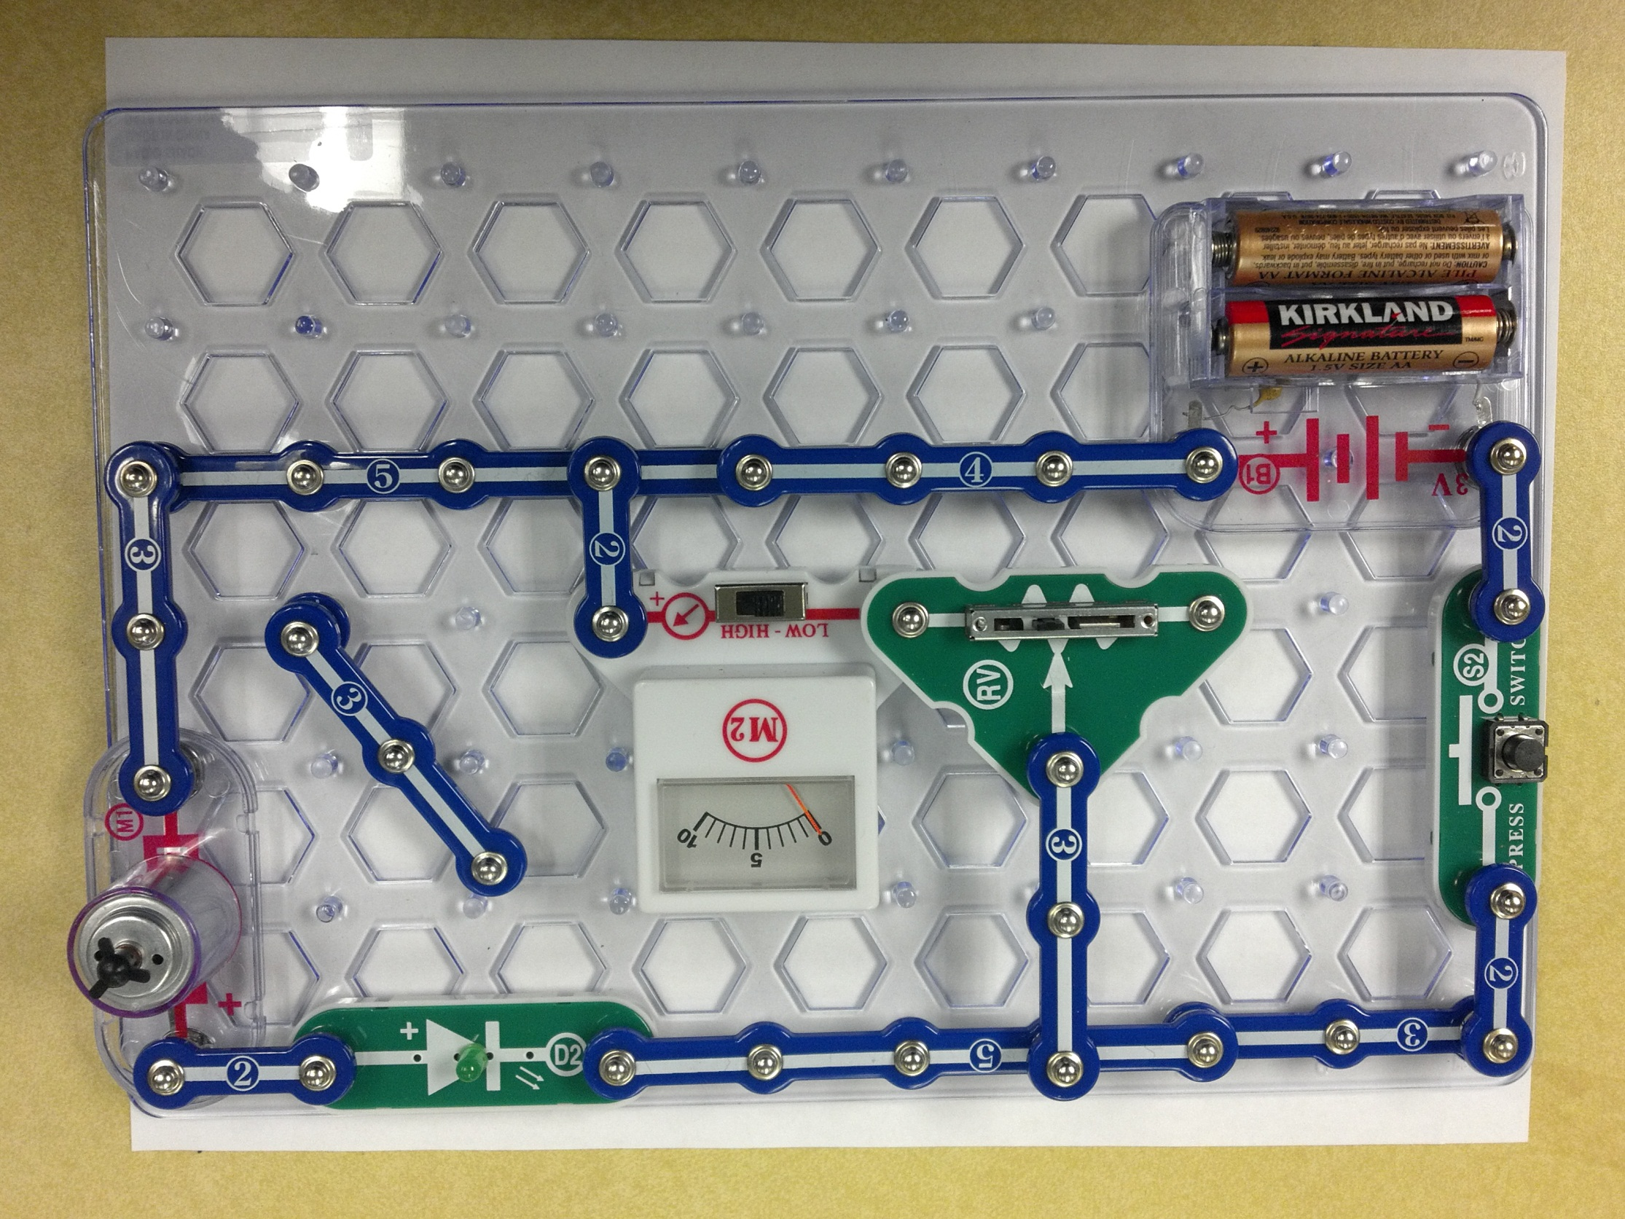
Hands-on Circuits Lab

Slide 34
Circuit Construction Kit, Virtual Lab
This web site allows students to create virtual circuits which include a battery (power source), conducting path (wires) switches (mechanical switch) and loads (lamp bulb). They may also use resistors and meters to explore parallel and series circuits.
Material Type: Simulation
Notes:
Build circuits with resistors, light bulbs, batteries, and switches and take measurements with laboratory equipment like the realistic ammeter and voltmeter.
Instructional Material: Virtual Circuit Web Site
Submitted by Randy Steele on 9 November, 2011 - 17:10
This web site allows students to create virtual circuits which include a battery (power source), conducting path (wires) switches (mechanical switch) and loads (lamp bulb). They may also use resistors and meters to explore parallel and series circuits.
Material Type: Simulation

Slide 35
Circuits & Computers - Review
Jeopardy
Notes:
This is the Unit review. Only the far left category (Circuits) is covered in this lesson.
“I only have my class “question” the Circuit column answers. They all want to try the rest but I tell them those columns will be used when we get to the lessons that cover that material. An effective Hook ☺ “ Roger Hull

Slide 36
Worksheet
Circuits & Switches
Name:___________________ Period:___ Date:_____ Score:__/15
(2 pts) Name the four parts of a circuit:
(4 pts) Briefly describe each of the four parts:
(3 pts) Give an example of a circuit in your world (other than the power grid in the video, or a flashlight), and identify its four parts:
(3 pts) What are the characteristics of an insulator, conductor and semiconductor.
(3 pts) Give an example of an insulator, conductor and semiconductor
Notes:
Review the Circuits and Switches Worksheet with students before watching the Intel Video: Circuits and Switches
Answer Key: Circuits & Switches Worksheet
Power source Conducting Path Switch Load
Power source – pump that pushes electrons around the circuit (e.g. battery) Conducting path – path through which electrons move (e.g. wires) Switch – means to turn on and off the flow of electrons (e.g. light switch) Load – part of the circuit that does something useful (e.g. light bulb)
Many possible answers, for example: Flashlight - Power source: batteries, Conducting path: wires, Switch – slider switch, Load – lamp bulb
Conductors allow electrons to move freely Insulators do not allow electrons to move freely (they don’t conduct) Semiconductors allow electrons to move freely only under certain conditions, and do not under other conditions (act like either a conductor or insulator, depending on the conditions)
Assessment: Circuits and Switches_Worksheet
Submitted by Randy Steele on 10 July, 2011 - 15:18
Printer-friendly versionPDF version Assessment Type: Written quiz / test
The attached Circuit and Switches Worksheet Word file is used in conjunction with the Intel video "Circuit and Switches" from "The Journey Inside: The Computer" series.
Attached Resource: Circuit and Switches Worksheet.doc
Answer key: Circuits and Switches_Worksheet

